Slide 1
The Immune System: An Overview
Shiv Pillai MD, PhD
Ragon Institute, Massachusetts General Hospital
Harvard Medical School
Some slides made using Biorender

Slide 3
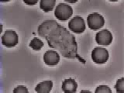
Magic for a melancholic mind

Slide 4
Innate vs Adaptive Immunity
Innate Immunity
(Immediate, not specific)
Adaptive Immunity
(Takes days, very specific, HUGE repertoire)

Slide 5
Innate Immunity
Inflammation
The anti-viral state

Slide 6
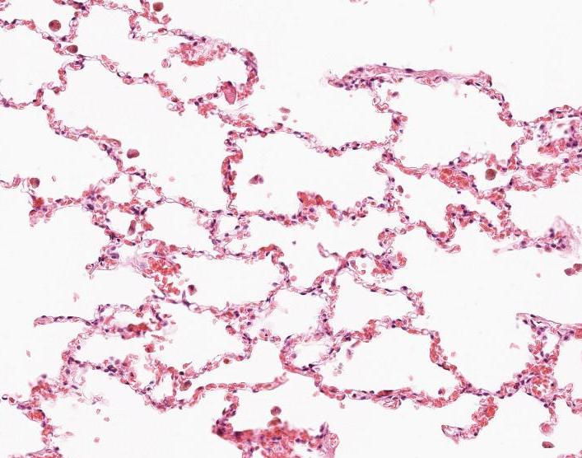
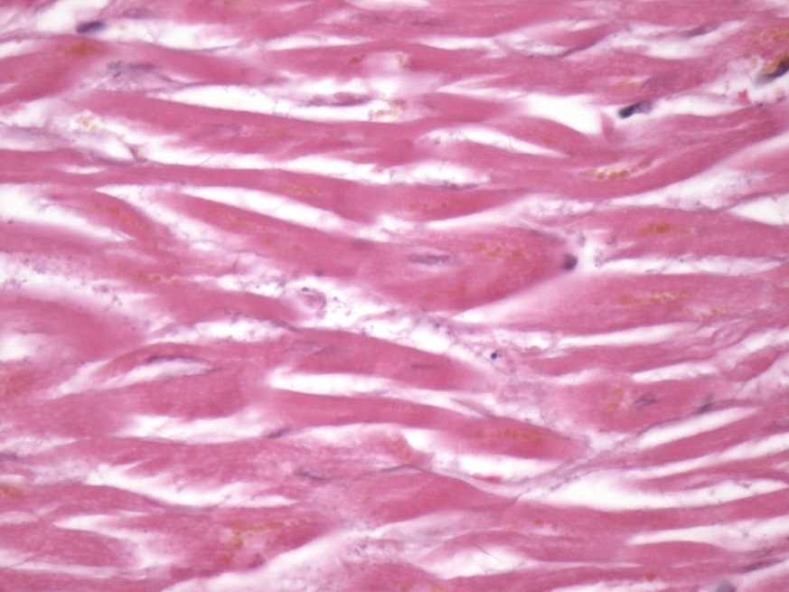
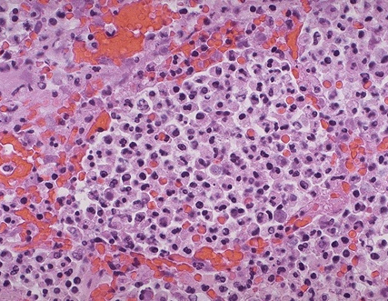
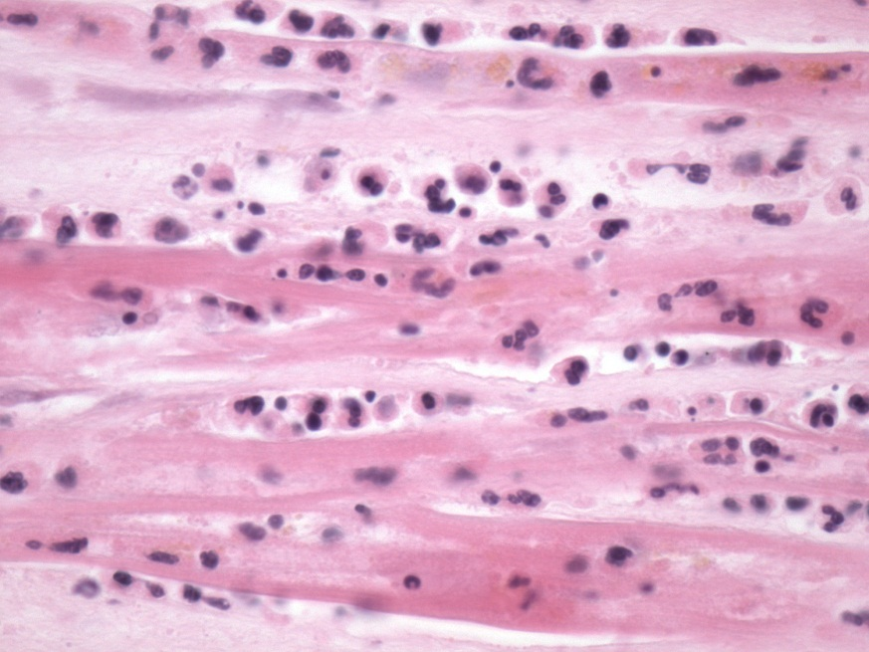
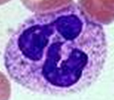
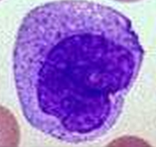
Acute Inflammation:
An Innate Immune Response to Infection or Sterile Injury
Normal Lung
Normal Heart
Infected Lung
Myocardial Infarction

Slide 7
Tissue Sentinels: Macrophages and Mast Cells

Slide 8
BARRIER DISRUPTION AND PENETRATION BY PATHOGENS

Slide 9
Neutrophil Recruitment and Inflammation

Slide 10
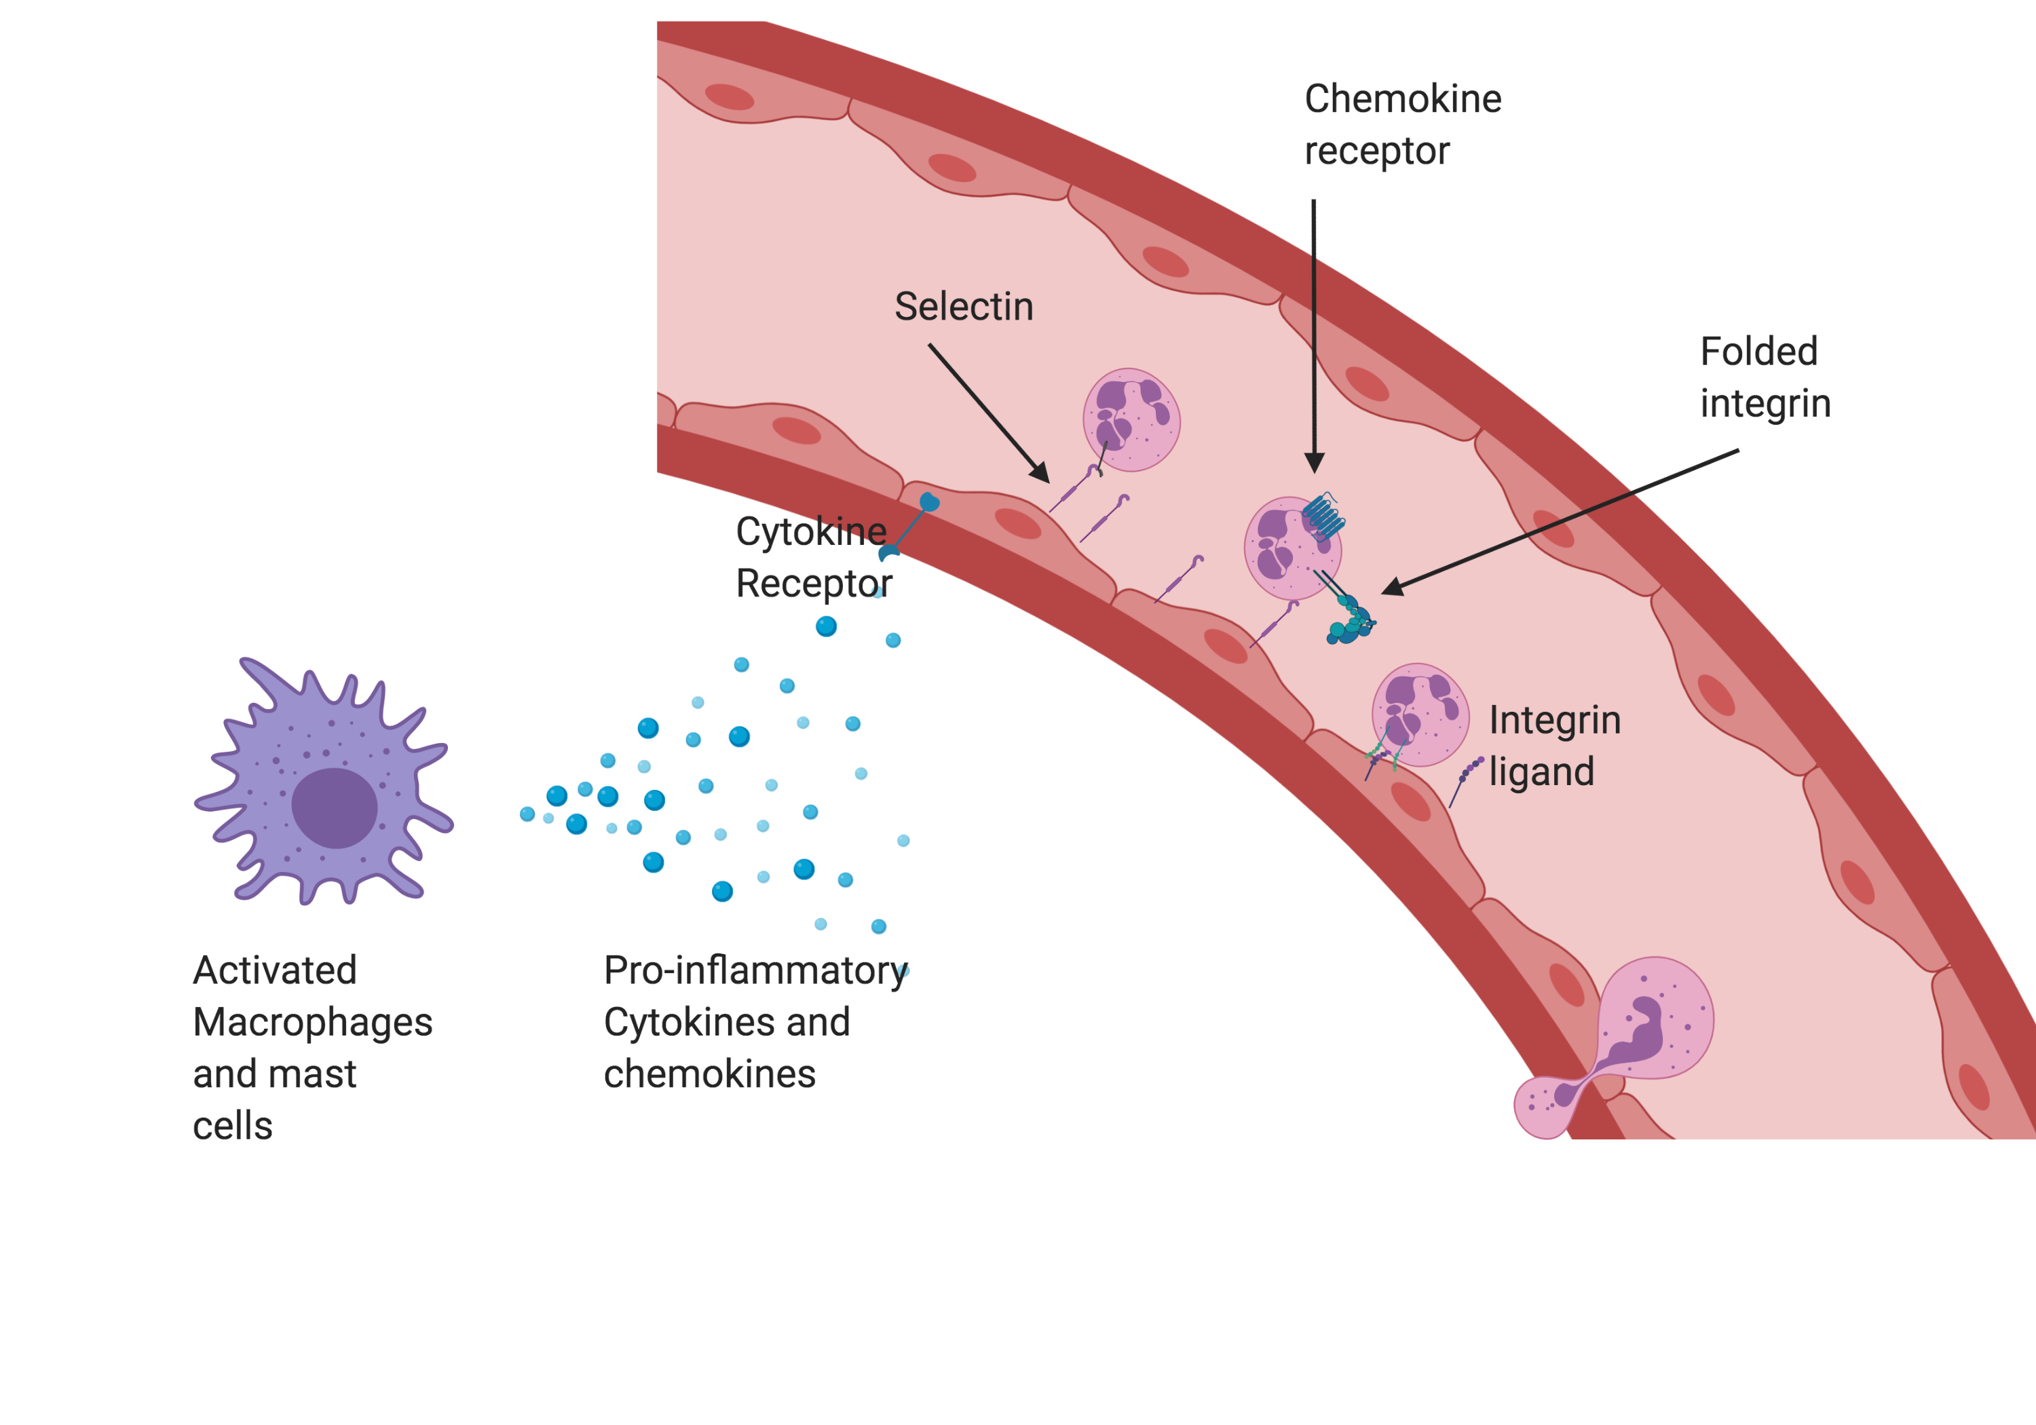
Three step model for leukocyte migration

Slide 11
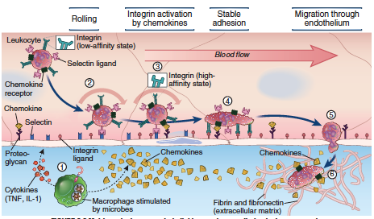
3-Step Model

Slide 12
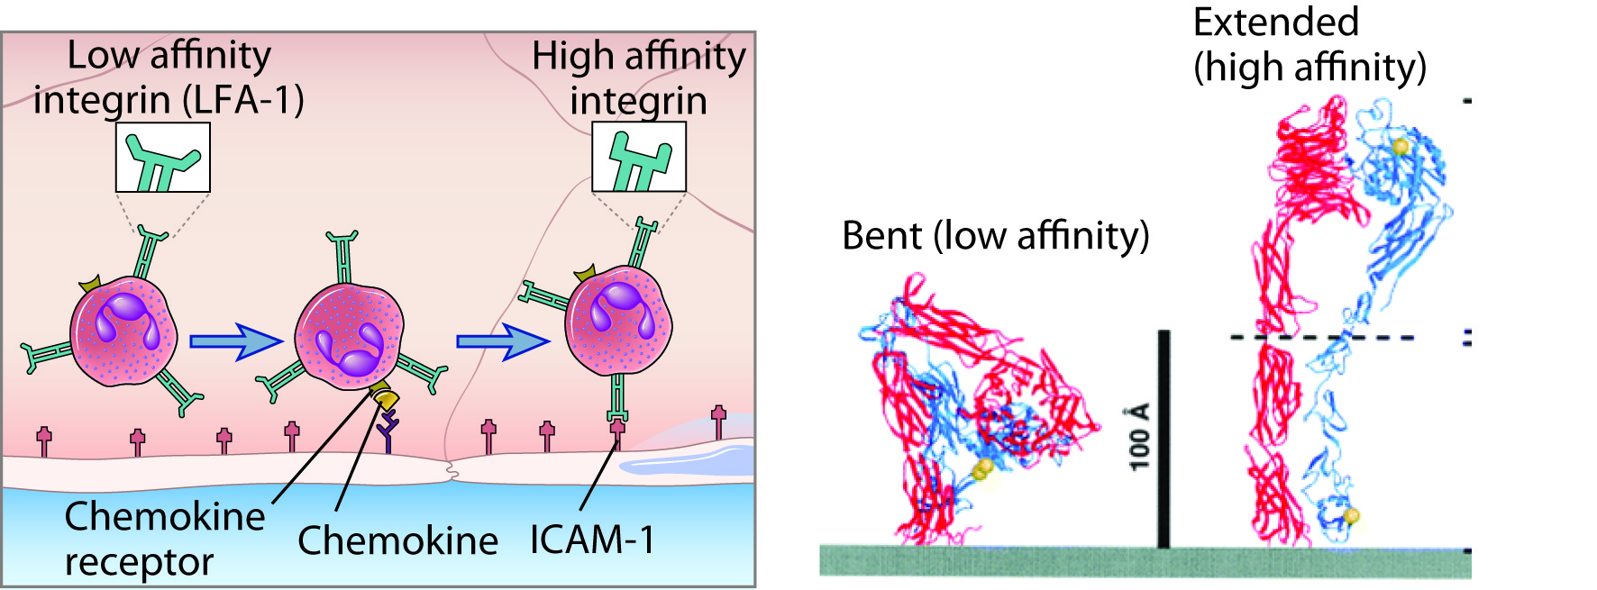
Integrin Activation by Chemokines

Slide 13
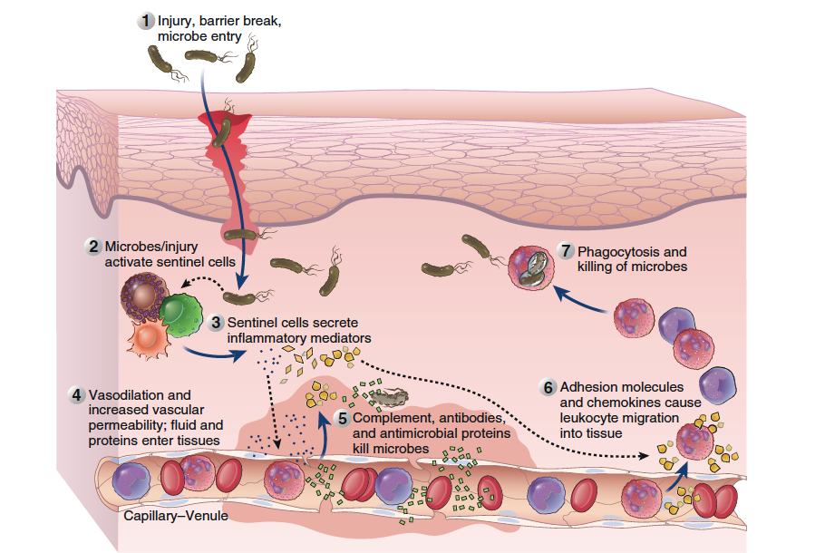
An overview of Inflammation
From Abbas, Lichtman and Pillai, CMI Elsevier.

Slide 14
Pus and Glory…..

Slide 15
HUMORAL AND CELL-MEDIATED IMMUNITY

Slide 16
The central questions of Immunology
GOD
Self-Non-self Recognition

Slide 17
antigen
clonal
expansion
secretion of
antibodies

Slide 18
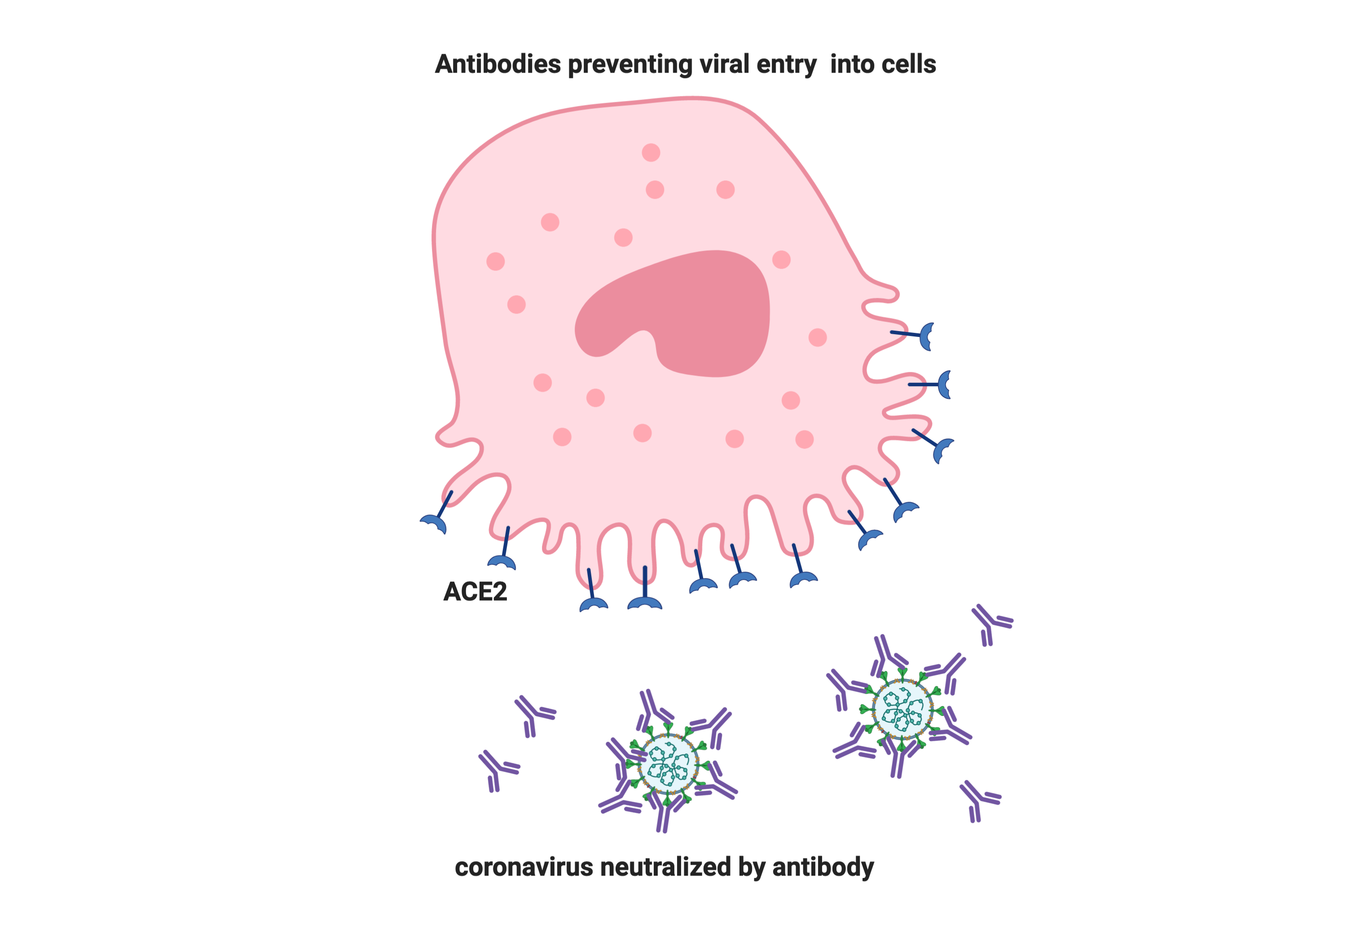
NEUTRALIZING ANTIBODIES BLOCK ENTRY OR NEGATE FUNCTION

Slide 19
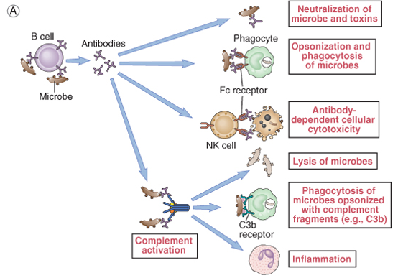
The effector functions of antibodies

Slide 20
Why do we need T cells?

Slide 21
T cells ignore soluble shapes- only
recognize “billboards” with peptides

Slide 22
The “rules” of adaptive immunity
Developing lymphocytes mature and are tolerized in
central lymphoid organs (VDJ recombination and Central Tolerance)
Naïve lymphocytes home to secondary lymphoid organs (SLOs -
mainly lymph nodes) in search of antigens
Lymphocytes require two signals for activation (occurs in SLOs)
and develop into effector and memory cells
Effector lymphocytes migrate out of SLOs to sites of infection
Eradication of infection, Contraction of Effectors and Memory

Slide 23
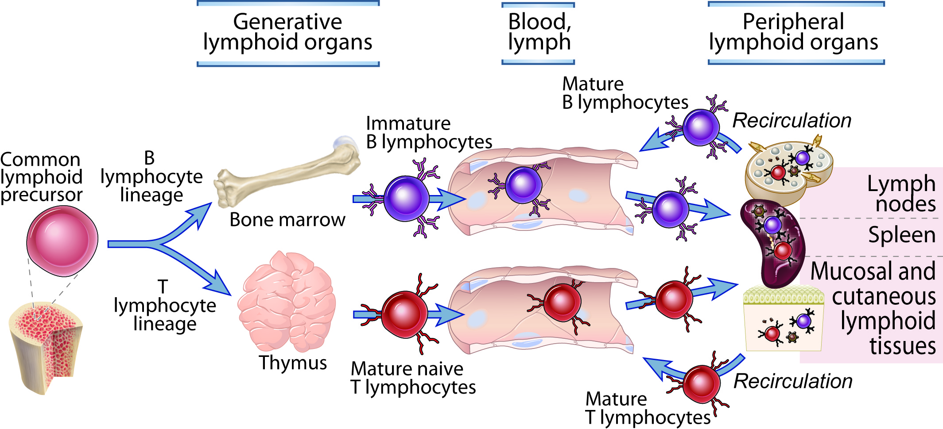
Maturation of Lymphocytes

Slide 24
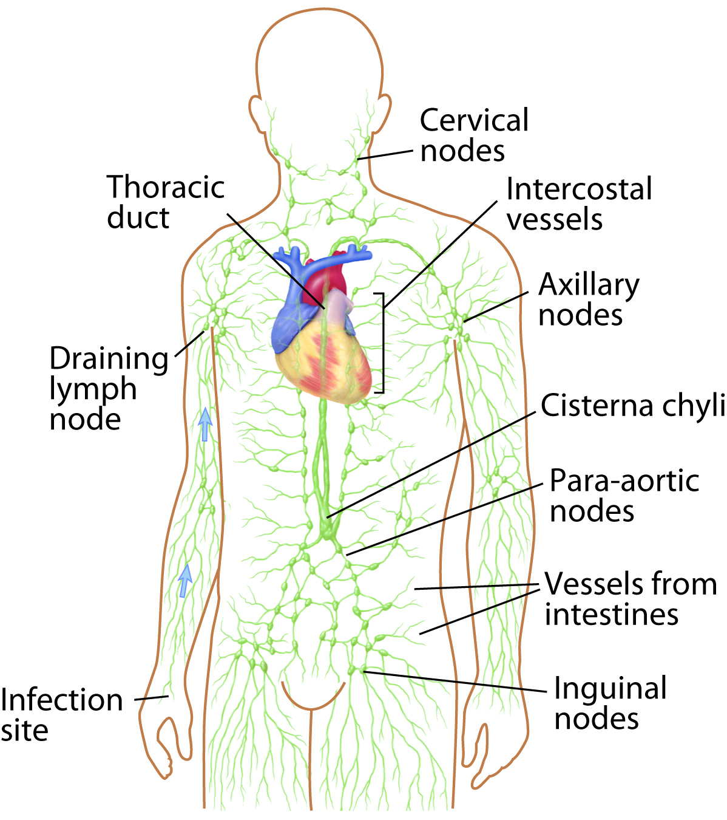
The Lymphatic System

Slide 25
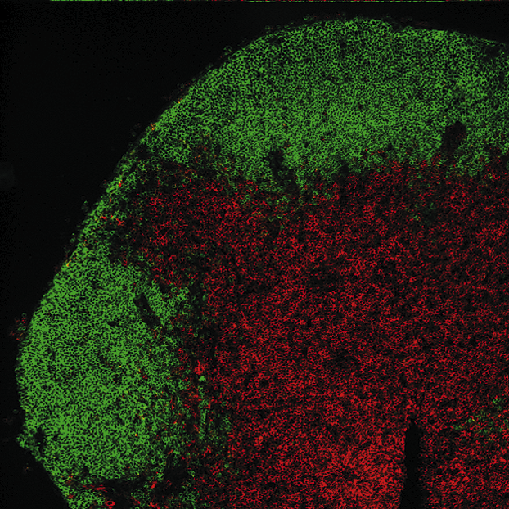
SLOs - T and B cell zones

Slide 26
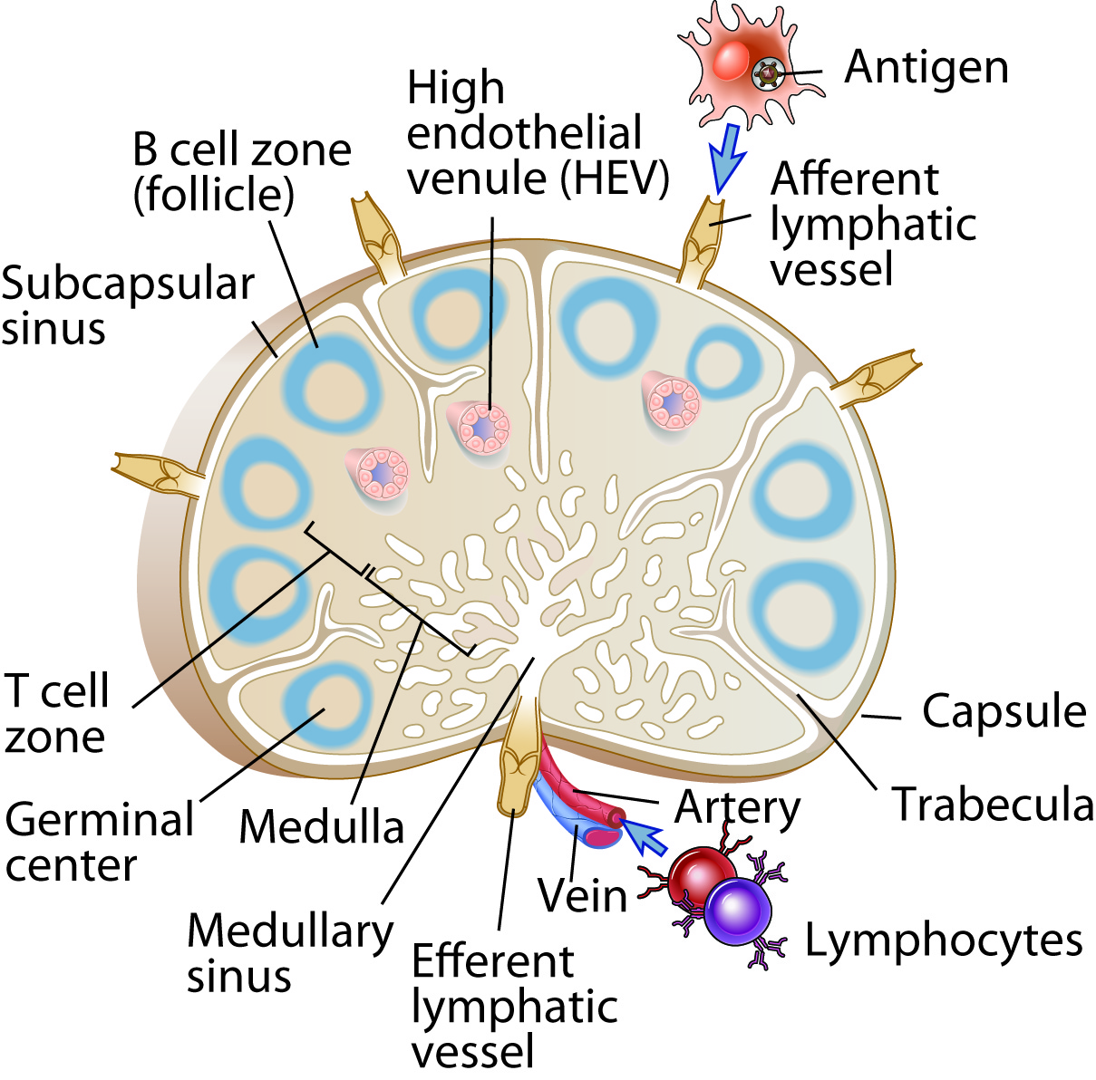
Lymph Node Morphology

Slide 27
A Third Type of Sentinel Cell Initiates Adaptive Immunity

Slide 28
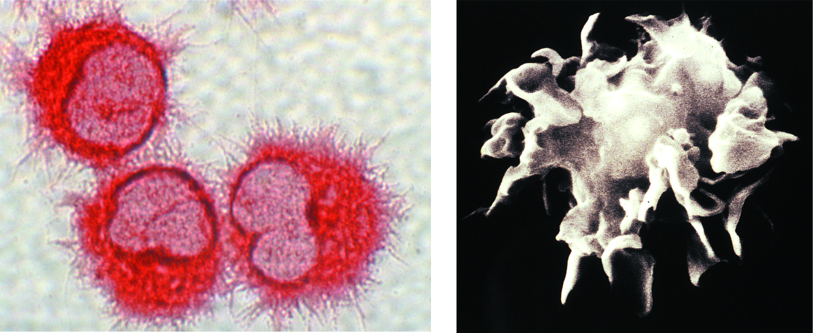
Dendritic Cells Initiate naive T cell activation

Slide 29
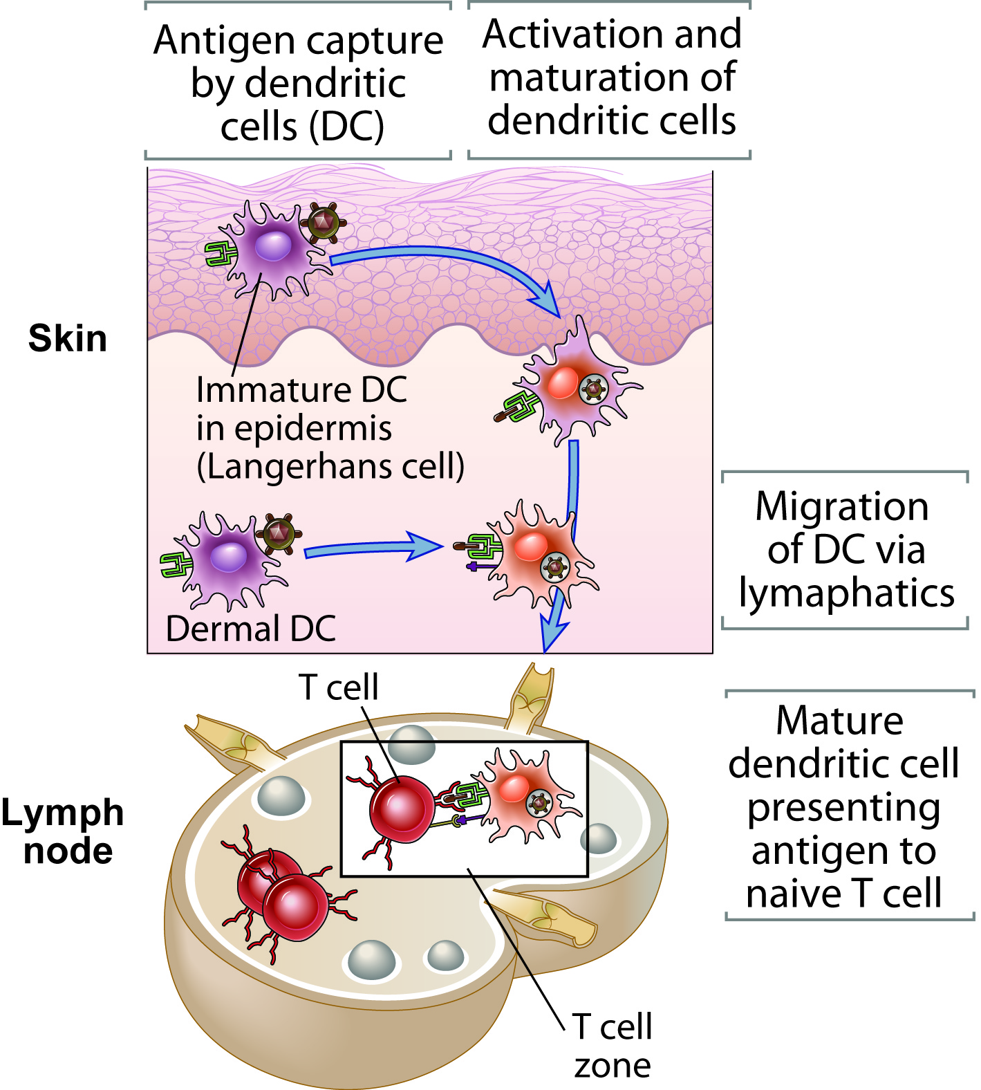
DC Antigen Capture and Presentation

Slide 30
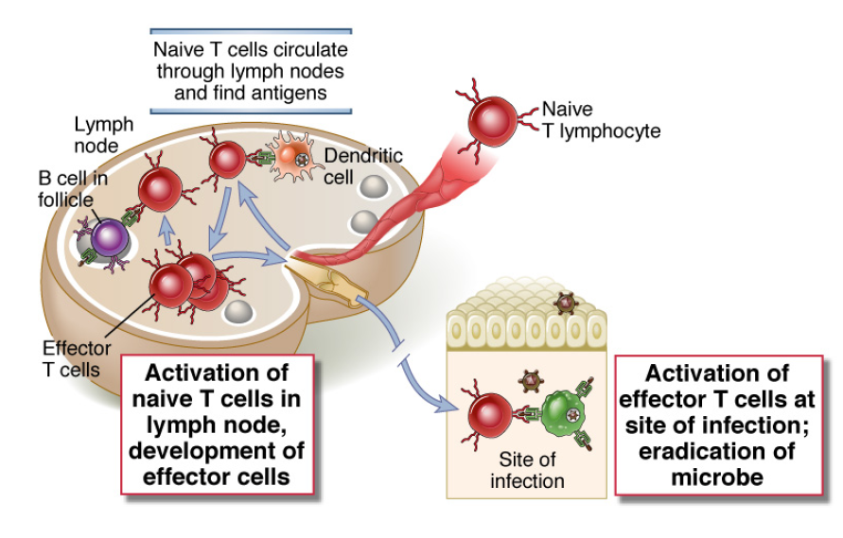
DCs and antigen find specific Naïve T cells in SLOs in the
T cell zone: activated Effector T cells return to the site of infection

Slide 31
Immunological Diseases
Autoimmunity
Chronic inflammation
Infections
Allergies
Transplantation
Immunodeficiencies
Cancer
Virtually everything –even Type II diabetes, atherosclerosis and trauma
New knowledge
=
New rational Therapies

Slide 32
THE ERA OF RATIONAL THERAPY HAS BEGUN
INHIBITING IMMUNITY
Autoimmunity, Transplantation, Allergies
Biologicals: Many – Rituxan,Tysabri etc
Small molecules: CsA, FK506, rapamycin, Inhibitors of Btk, Syk, JAKs etc etc.
ENHANCING IMMUNITY
Cancer, HIV
Biologicals: Inhibitory receptor blockade (Ab to
PD-1, CTLA-4)
Small molecules: coming

Slide 33
The center cannot hold…..

